Slide 1

STUDENT MANAGEMENT
Presented by
Neha R. Nagdeve

Slide 2

INTRODUCTION
Full Stack Application –Student Management
This project “Student Management System” provides us a simple interface for maintenance of student information.
It can be used by educational institutes or colleges to maintain the records of students easily.
Achieving this objective is difficult using a manual system as the information is scattered, can be redundant and collecting relevant information may be very time consuming. All these problems are solved using this project.

Slide 3
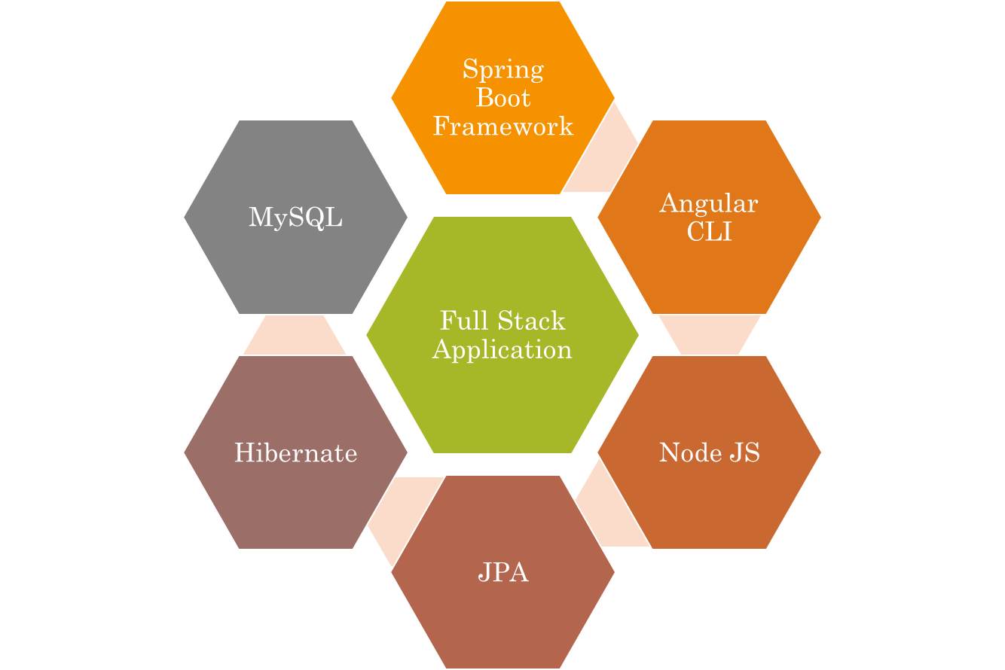
Technologies used.

Slide 4
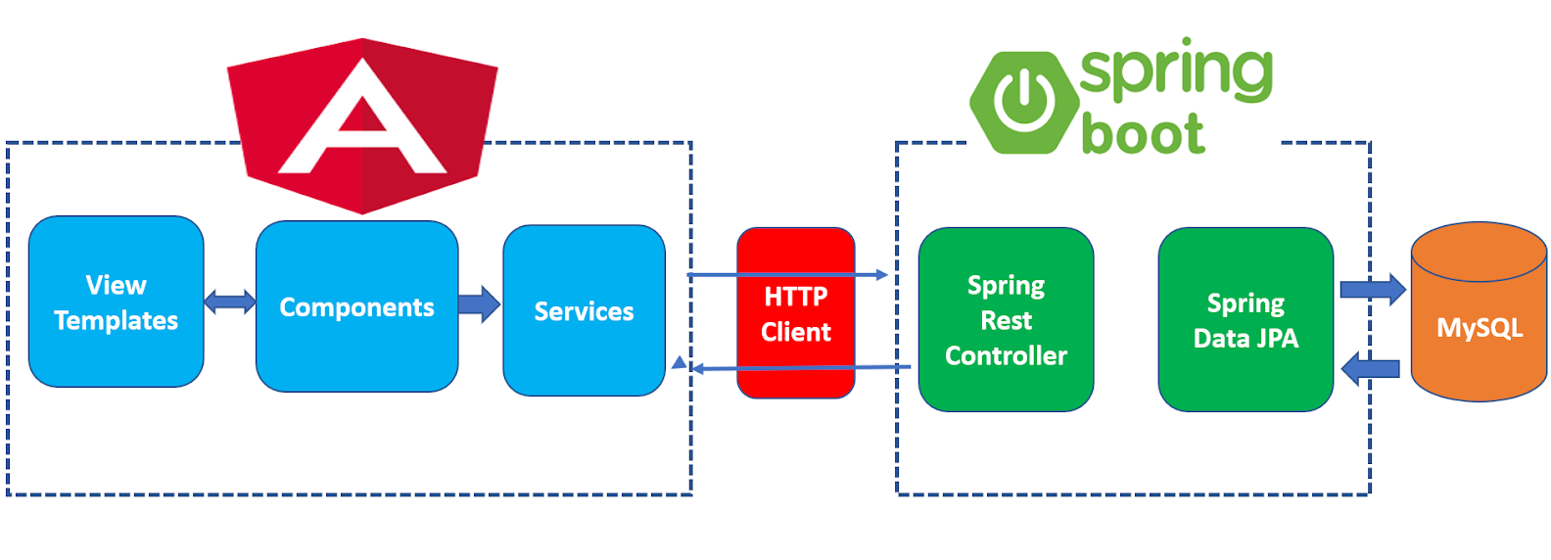

The Architecture of Angular, Spring
)
& database(MySQL

Slide 5
The Architecture of the Project
Angular JS
Node JS
Frontend
Spring Boot
Backend
MySQL

Slide 6
CRUD Operations
View Record
Update Record
Delete ID
CRUD
Add Student

Slide 7
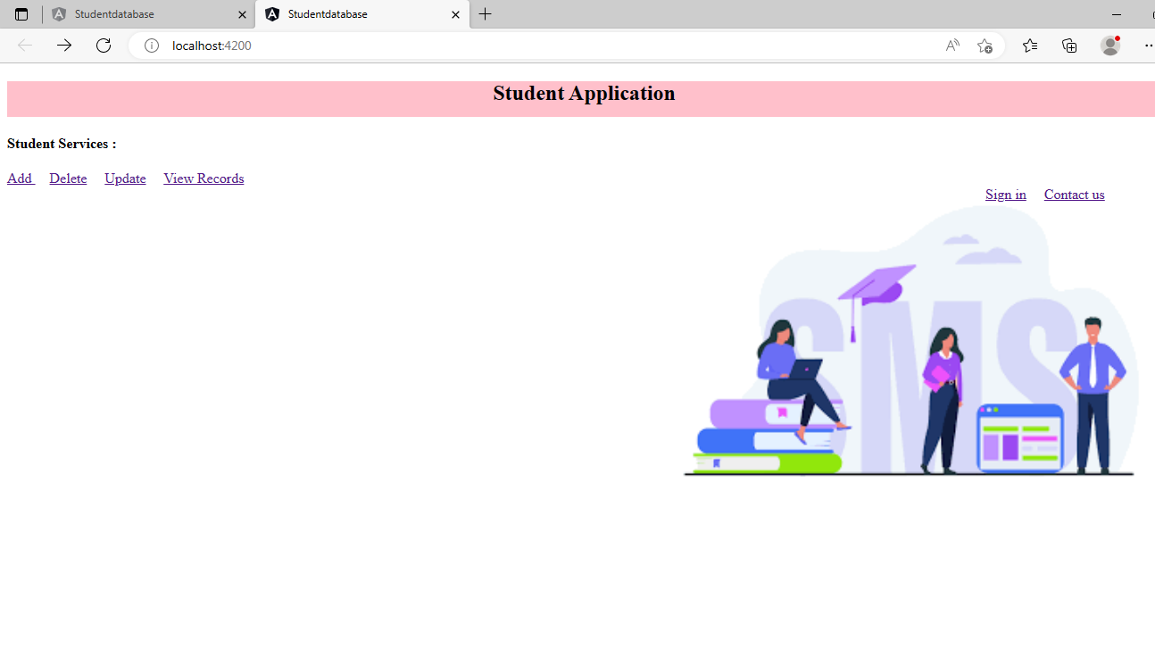
Home Page

Slide 8
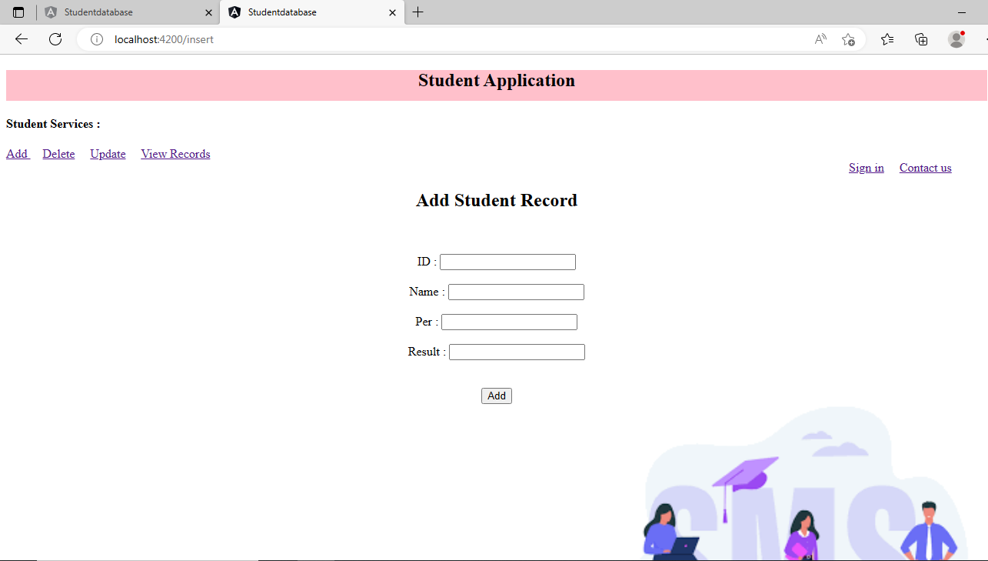
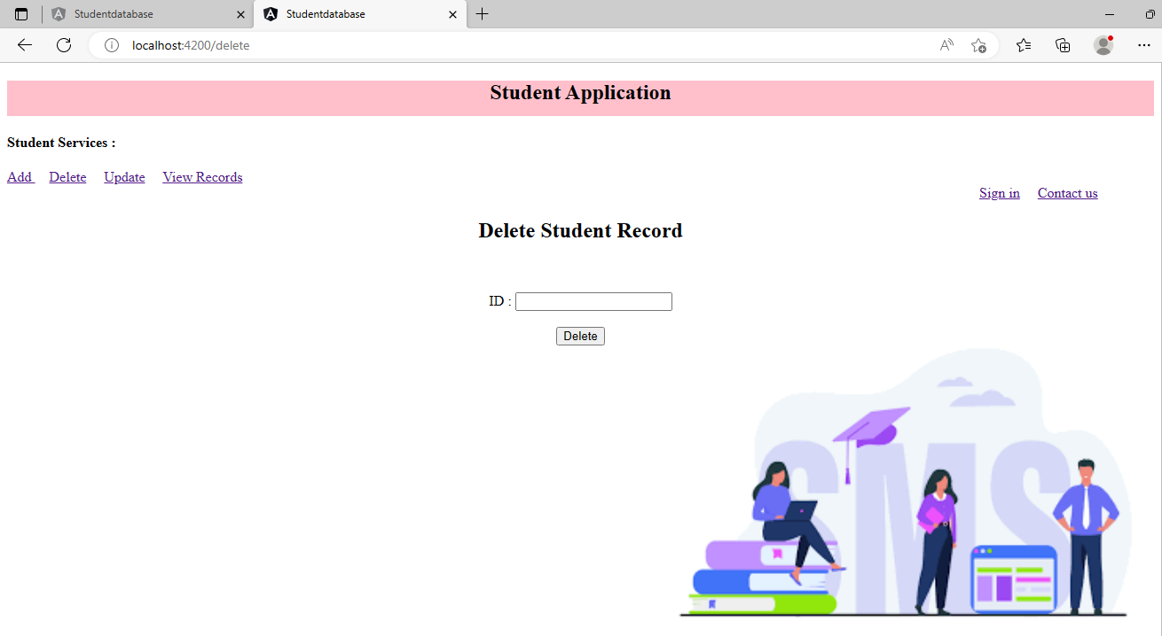
ADD & Delete Page.

Slide 9
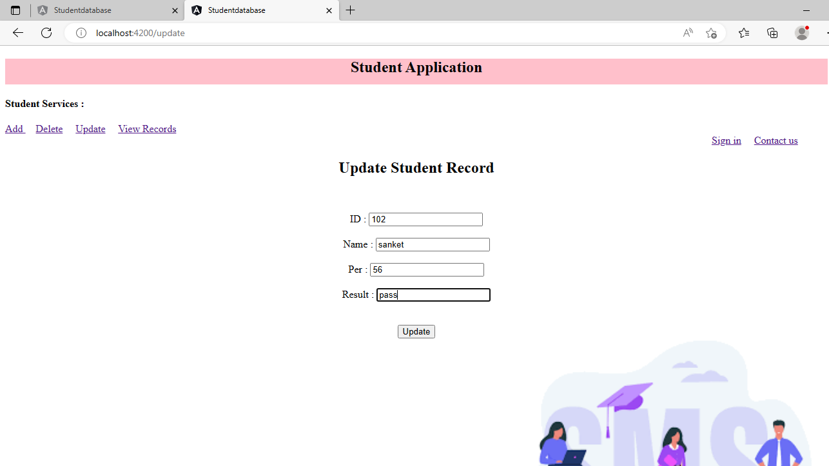
Update Page

Slide 10
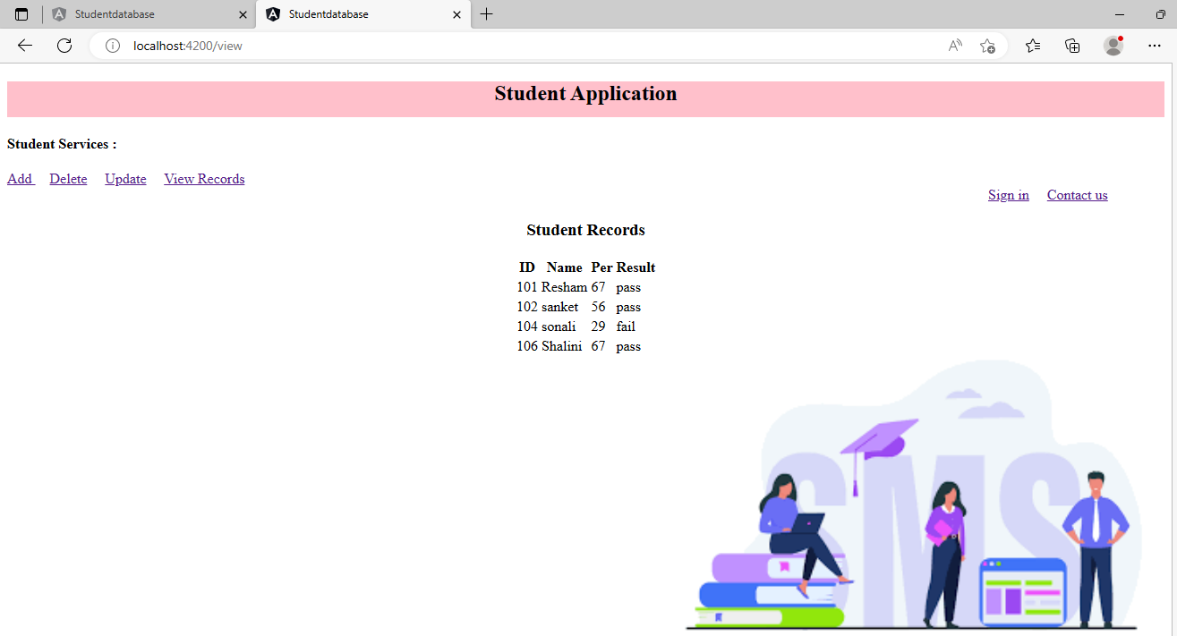
View Record

Slide 11
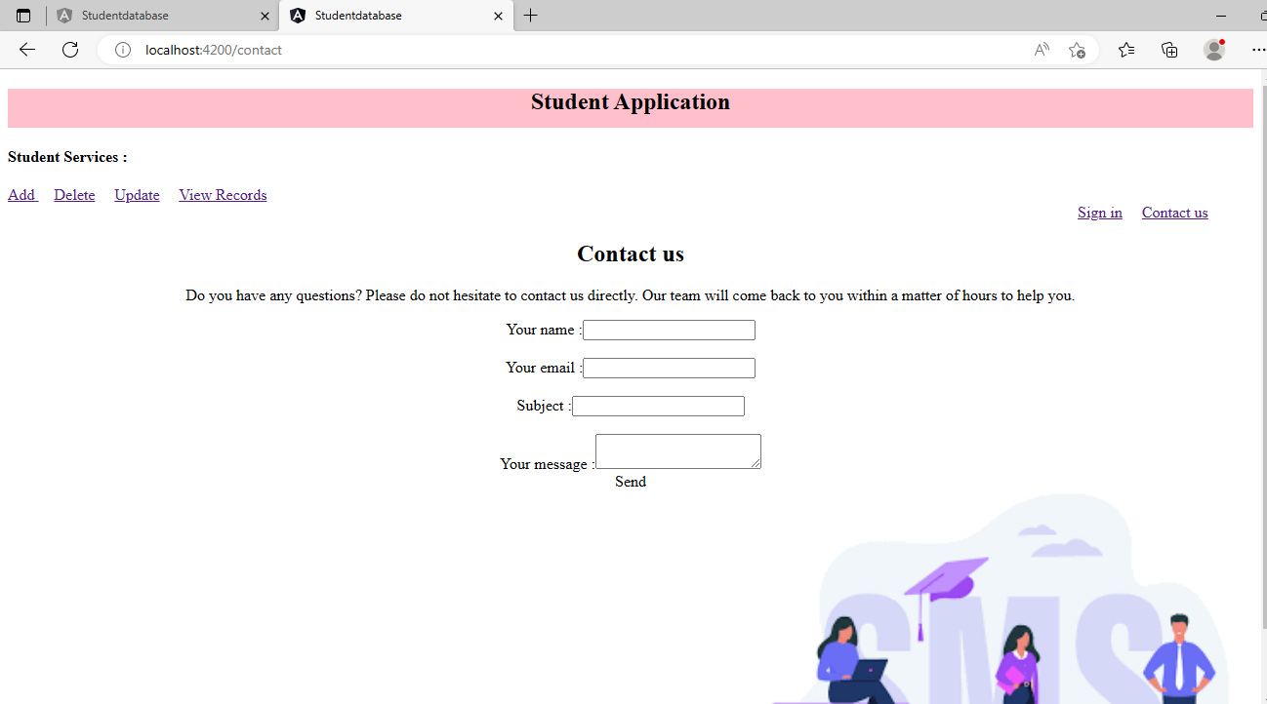
Contact us Page

Slide 12
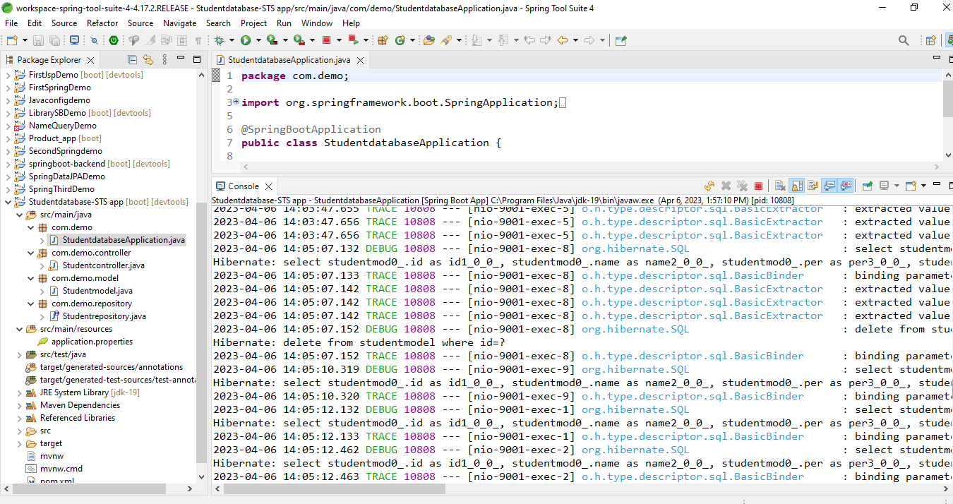
Spring Boot Application

Slide 13
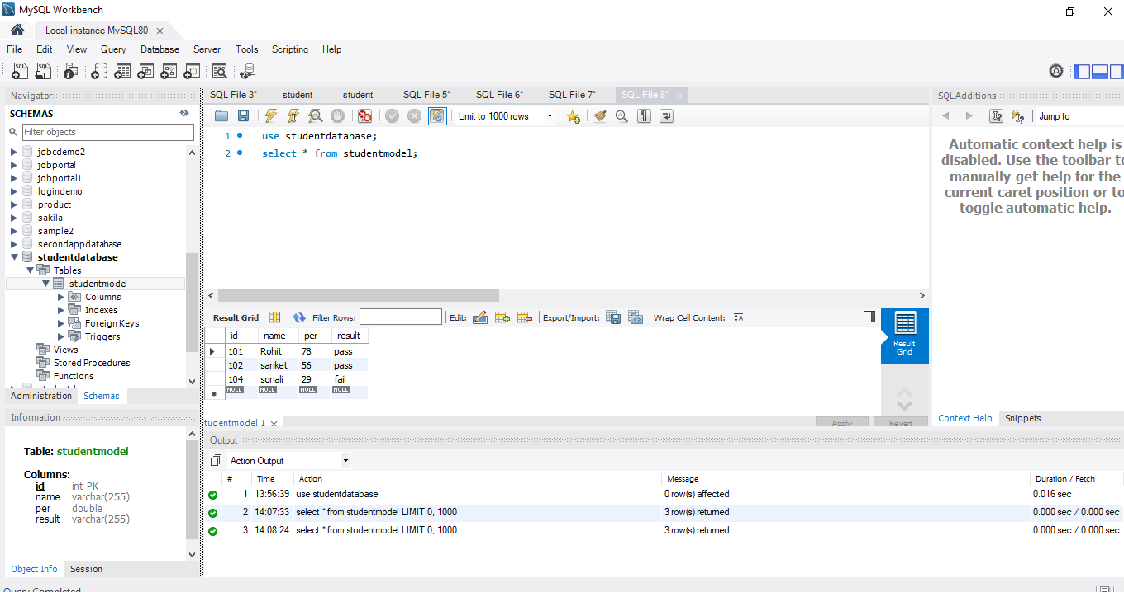
MySQL Code

Slide 14
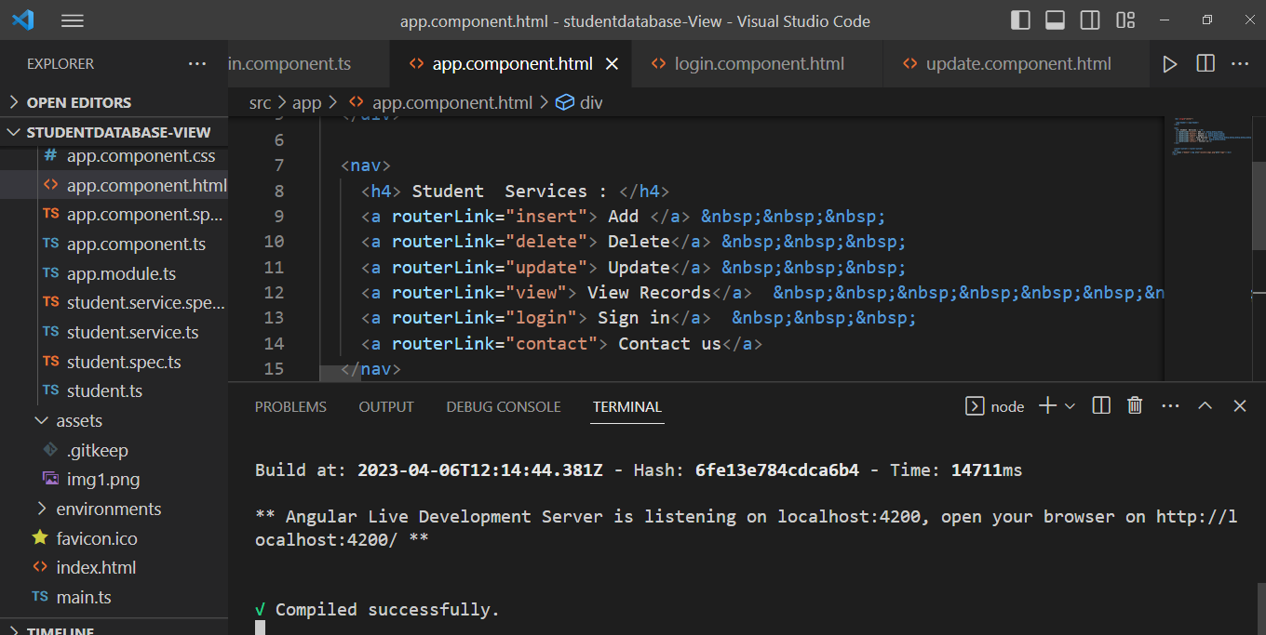
Frontend – Angular JS

Slide 15

The scope of this project is as follows:
The project can be implemented on intranet in future. Project can be updated in near future as and when requirement for the same arises
.
To utilize resources in an efficient manner by increasing their productivity through automation.
The system generates types of information that can be used for various purposes.

Slide 16

GitHub Link
https://github.com/NehaNagdeve/full-stack-student-management-system.git

Slide 17

Thank you.

